Slide 1
Final Project Presentation
Cameron McDavitt, Cameron Paul, Ola Nzeogu, Wenjie Ma, Deverell M

Slide 2
Purpose of system
The purpose of this system is to emulate the spotify app software. At the end of this project, a user should be able to search for a song of their choice, and the software should find the desired song from the used dataset and display it to the user. The machine learning aspect of the software should then be able to note when the user likes a song and should recommend more songs that are similar to the original song searched for by the user. The software uses Javascript, HTML/CSS, React, and Python for the machine learning.

Slide 3
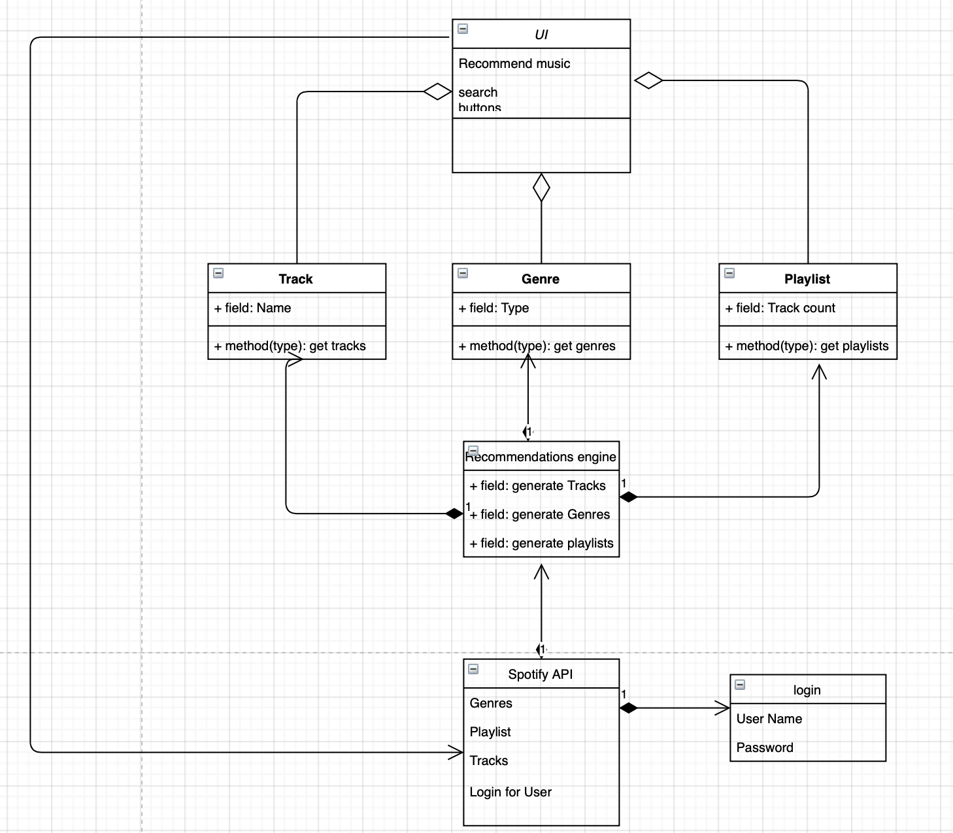
UML Class Diagram

Slide 4
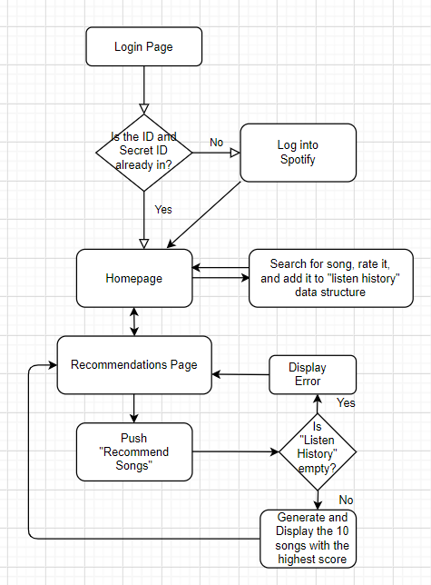
System statechart diagrams

Slide 5
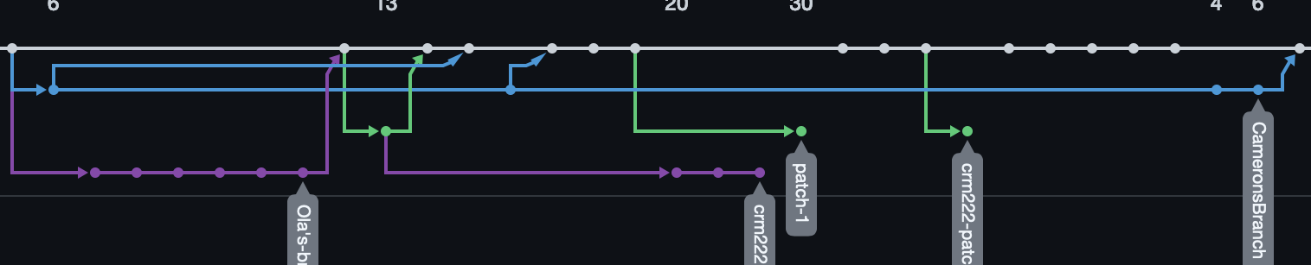
Github Flowchart

Slide 6
Machine Learning Program
Uses a Kaggle dataset for spotify (https://www.kaggle.com/yamaerenay/spotify-dataset-19212020-160k-tracks)
Due to space limitations, the data was trimmed to one file of 1000 songs with song name, id, artists, and popularity (songs with 77 popularity or lower were trimmed)
Runs a matrix algorithm known as a “TfidfVectorizer” through a sigmoid kernel, which compares artist name similarity for a given song to the artist names of the songs within the database.
The function runs with the name of a song as a parameter and returns the list of songs in order of most similar artist names to least similar. Requires the song name to be contained within the dataset.
Runs in python through pandas matrix manipulation and sklearn algorithms.
Disconnected from the front end.

Slide 7
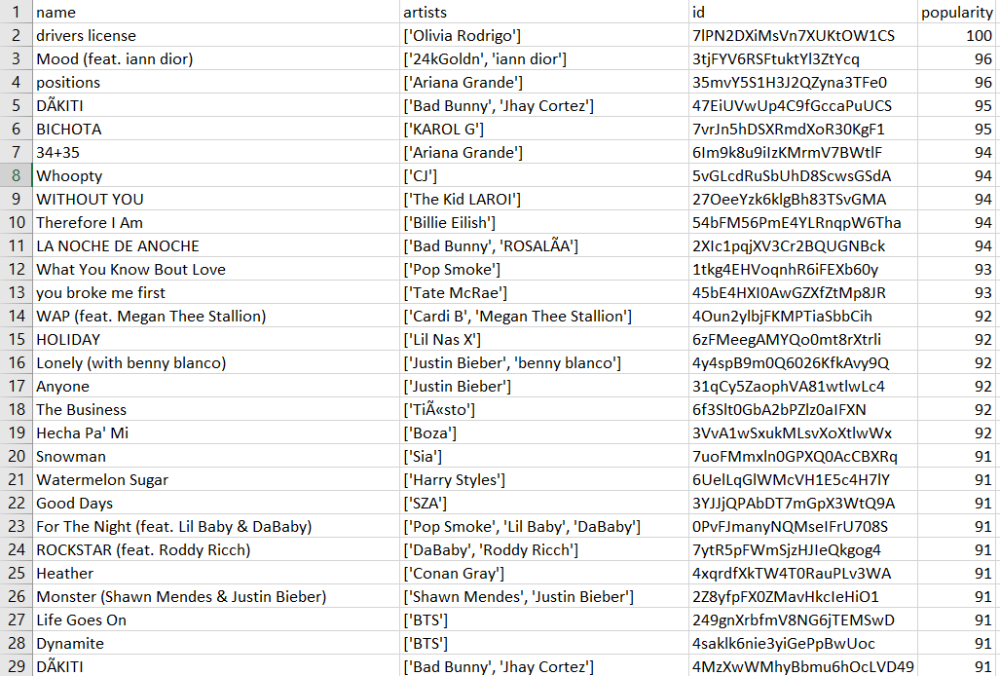
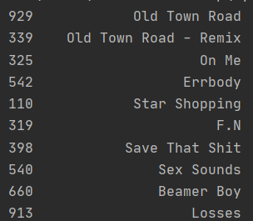
Data sample

Slide 8
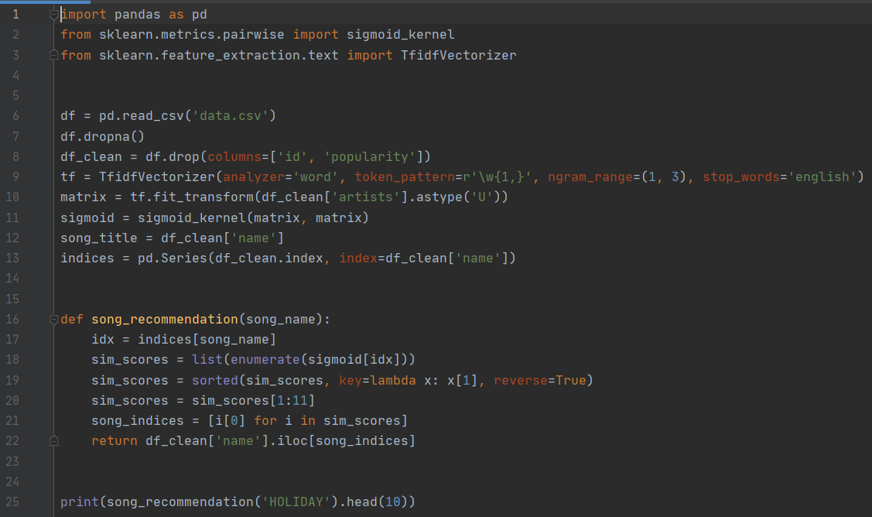

Slide 9
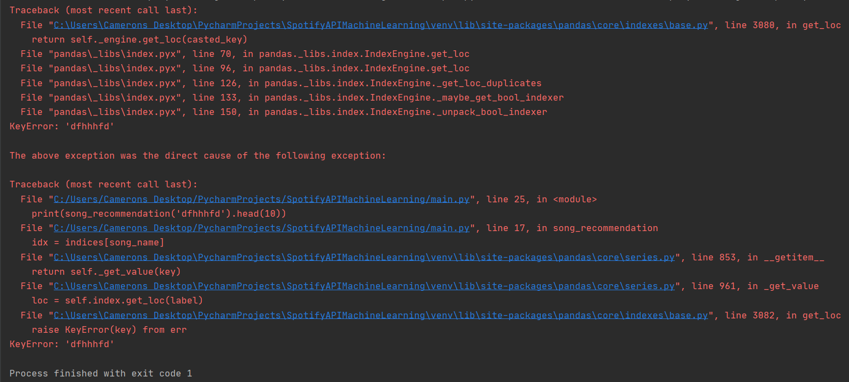
Machine Learning Test Cases
Case 1: Input a song that is in the dataset
Result: Generated list of 10 songs
Case 2: Input a song that is not in the dataset
Result: Key error, unhandled

Slide 10
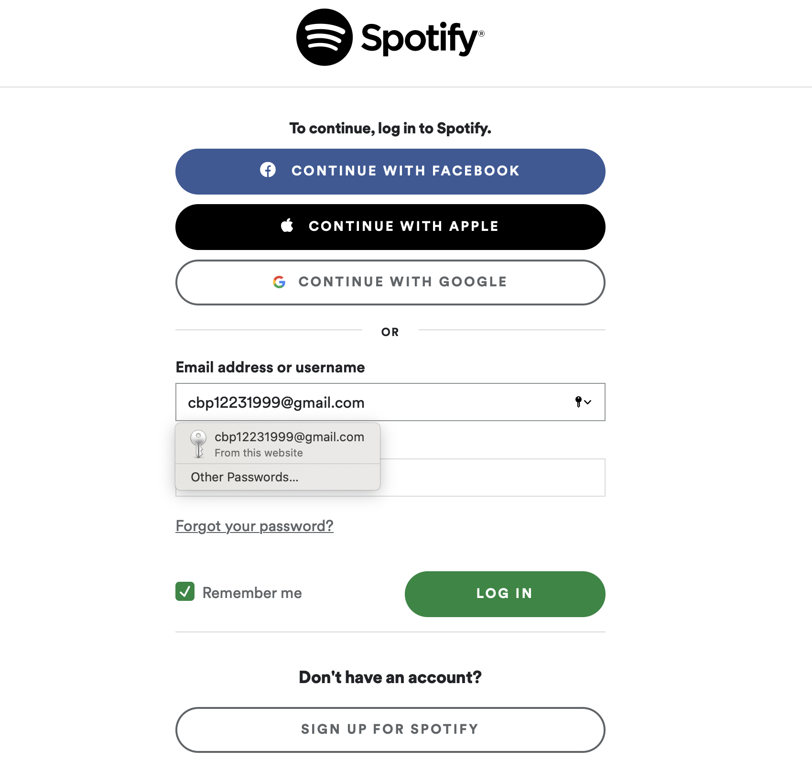
Login System

